Slide 1

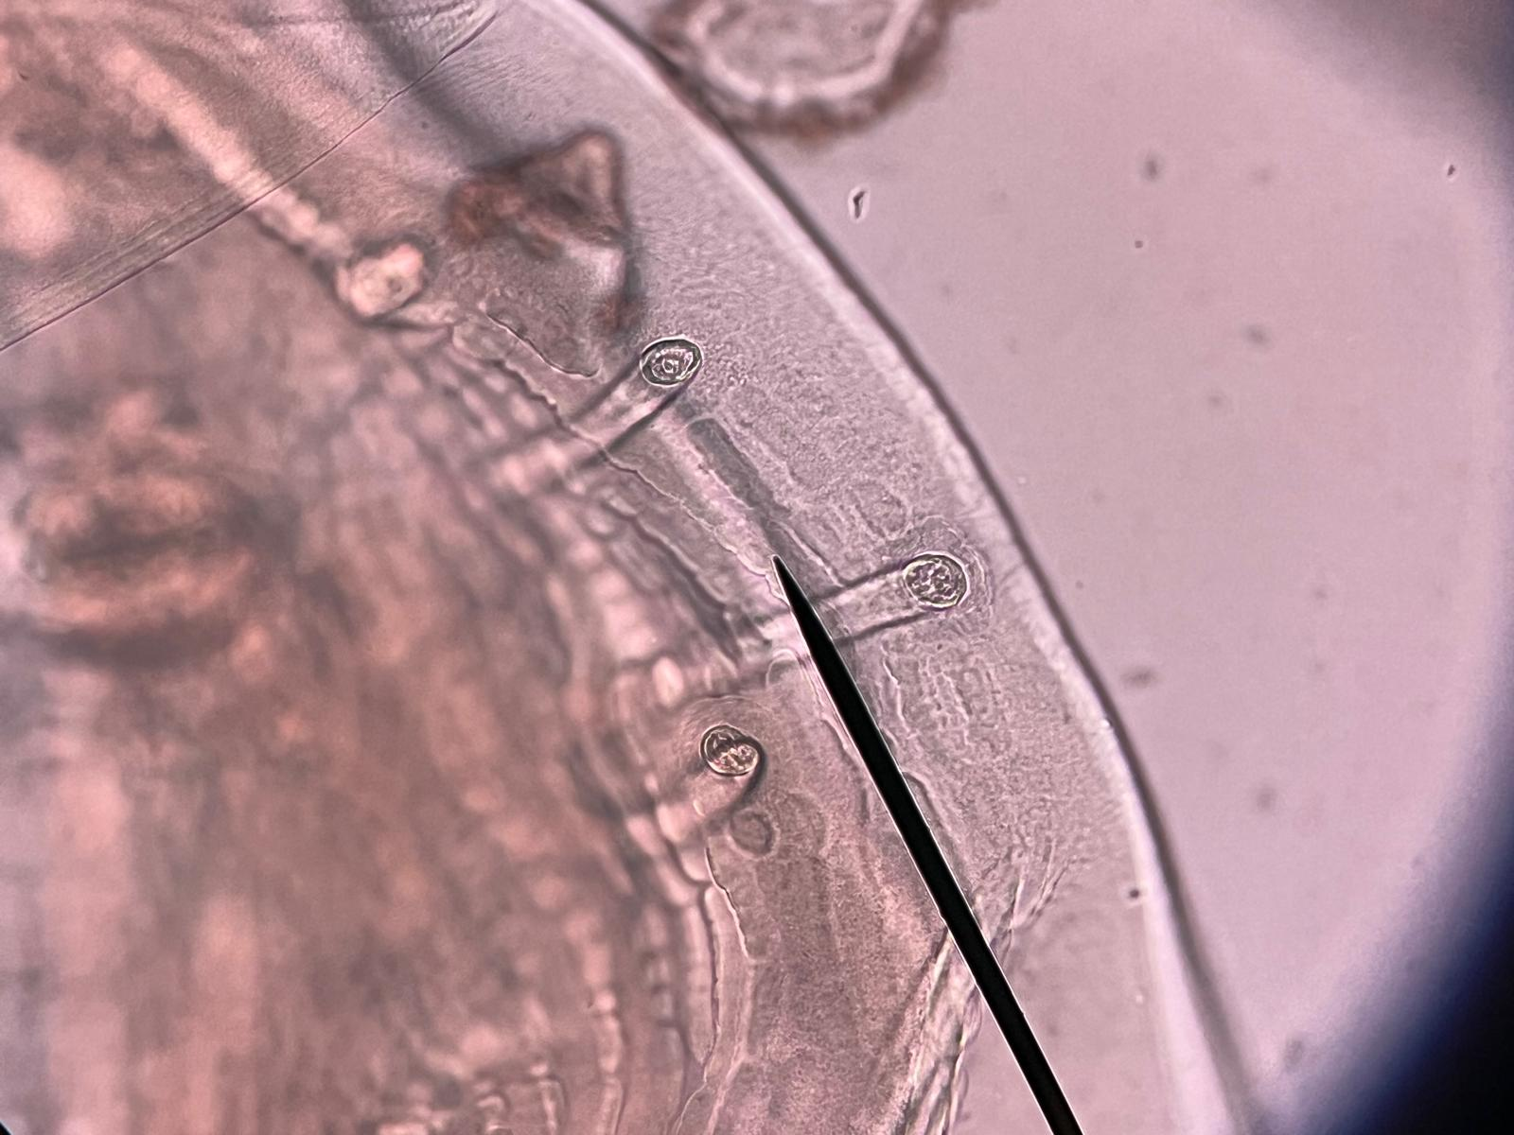
HookFuse
Diagnostic character measurement and shape analysis
Society for Evolutionary Parasite Systematics
SEPS:PRISM M. R. Dwyer
1
Notes:
Dwyer, M. R. (2026). SEPS:PRISM methodology reference, version 1.2, 18 October 2026. Society for Evolutionary Parasite Systematics. Current implementation includes manual and prototype paths; no validated end-to-end classifier claimed.

Slide 2
Two traced profiles in one source frame
Quantity | R1 | R2
Area (px²) | 2856.20 | 3292.88
Perimeter (px) | 193.05 | 205.84
Maximum Feret (px) | 68.84 | 73.54
Minimum Feret (px) | 52.02 | 59.87
Circularity | 0.9631 | 0.9766
SEPS Nematode Profile Morphometry. Two assistant-initialized polygons in 2023BaViNematode9(3).jpg. No physical calibration or independent specimen replication.
SEPS:PRISM M. R. Dwyer
2
Notes:
SEPS Nematode Profile Morphometry. Two assistant-initialized polygons in 2023BaViNematode9(3).jpg. No physical calibration or independent specimen replication.

Slide 3
Feret ratios describe the selected outlines
SEPS rim_metrics.csv. Feret ratio is not eccentricity. The differences concern two selected regions, not species means.
SEPS:PRISM M. R. Dwyer
3
Notes:
SEPS rim_metrics.csv. Feret ratio is not eccentricity. The differences concern two selected regions, not species means.

Slide 4
Fourier reconstruction and anatomy
Numerical result
Biological interpretation
At eight harmonics, RMS error equals 0.0973 px for R1 and 0.1164 px for R2.
The reference is the selected polygon.
A close reconstruction reproduces the trace.
It cannot establish that the analyst chose the correct anatomical boundary.
Retain vertices, normalization and harmonic count.
SEPS:PRISM M. R. Dwyer
4
Notes:
Kuhl & Giardina (1982), doi:10.1016/0146-664X(82)90034-X. SEPS Fourier_Reconstruction_Error.csv and Nematode Profile Morphometry report.

