Slide 1

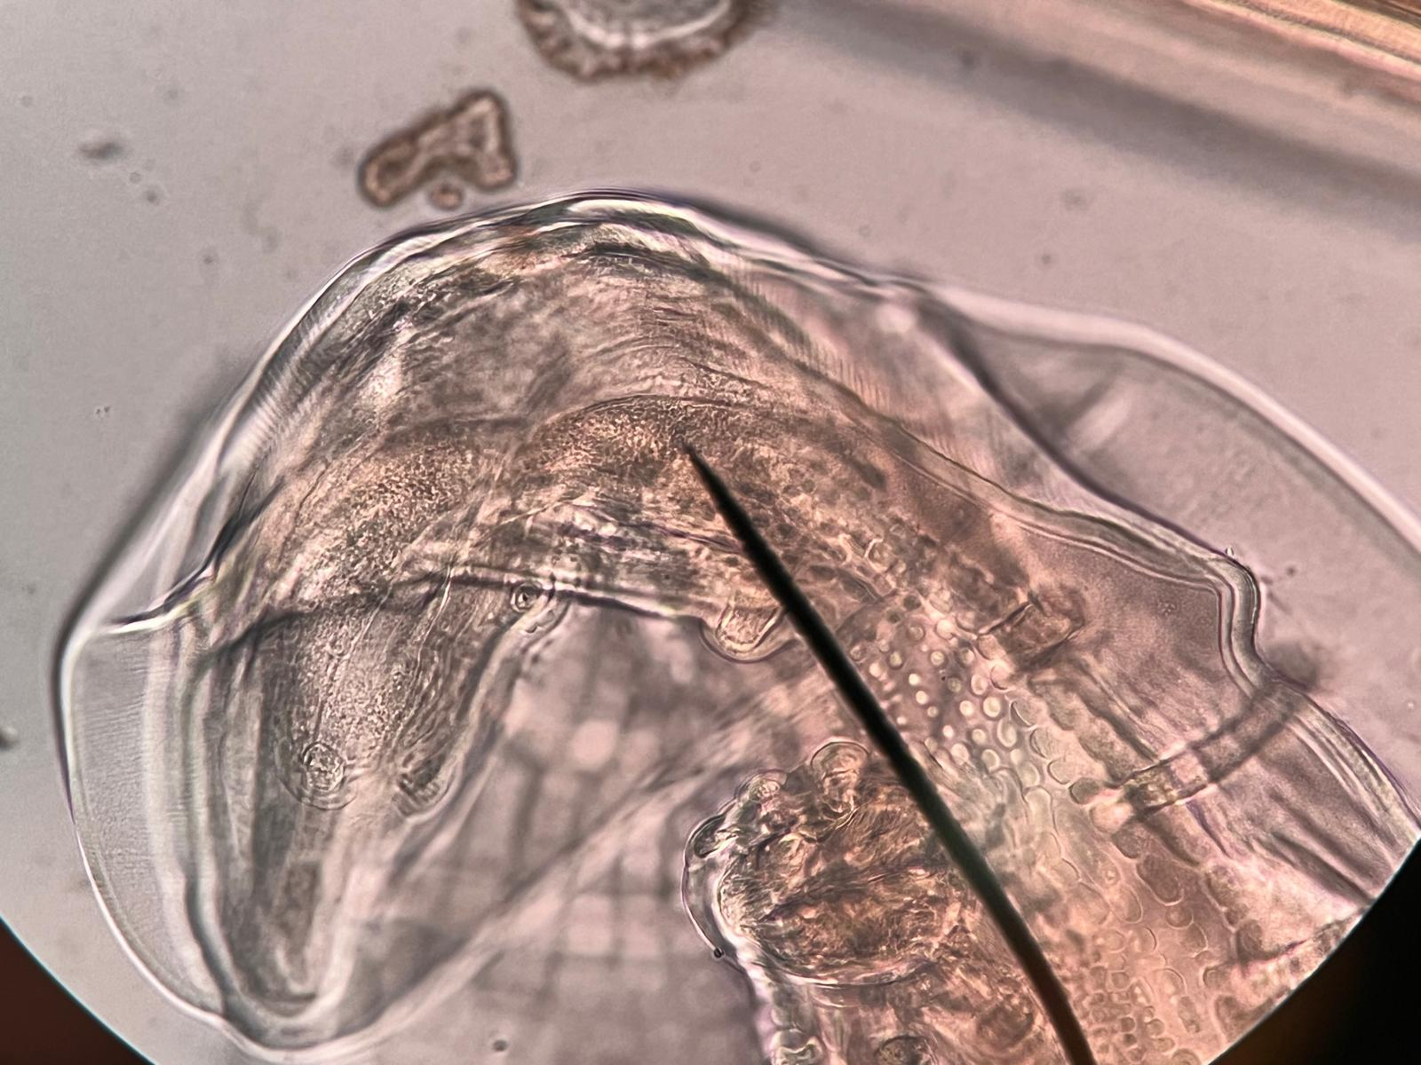
TEGUMENT
Source-linked image preparation and boundary review
Society for Evolutionary Parasite Systematics
SEPS:PRISM M. R. Dwyer
1
Notes:
Dwyer, M. R. (2026). SEPS:PRISM methodology reference, version 1.2, 18 October 2026. Society for Evolutionary Parasite Systematics. Current implementation includes manual and prototype paths; no validated end-to-end classifier claimed.

Slide 2
Image preparation records
01
Original
02
Region
Retain pixels, checksum and acquisition metadata
Record crop coordinates in the original image
03
Boundary
04
Derivative
Review masks, overlap and clipped structures
Retain transforms and the source relationship
Current specification includes manual review and prototype paths.
SEPS:PRISM M. R. Dwyer
2
Notes:
Dwyer, M. R. (2026). SEPS:PRISM methodology reference, version 1.2, 18 October 2026. Society for Evolutionary Parasite Systematics. Current implementation includes manual and prototype paths; no validated end-to-end classifier claimed.

Slide 3
A boundary depends on the task
Task | Required review | Consequence
Whole-body outline | Continuity and overlapping organisms | Reject bridges across separate structures
Hook or spicule | Tip, base and view orientation | Partial visibility limits length claims
Egg profile | Wall and internal objects | Avoid including debris in the boundary
Stitched whole mount | Seams and local transforms | Verify scale throughout the composite
Dwyer, M. R. (2026). SEPS:PRISM methodology reference, version 1.2, 18 October 2026. Society for Evolutionary Parasite Systematics. Current implementation includes manual and prototype paths; no validated end-to-end classifier claimed.
SEPS:PRISM M. R. Dwyer
3
Notes:
Dwyer, M. R. (2026). SEPS:PRISM methodology reference, version 1.2, 18 October 2026. Society for Evolutionary Parasite Systematics. Current implementation includes manual and prototype paths; no validated end-to-end classifier claimed.

Slide 4
Evaluation of segmentation
Overlap
Diagnostic completeness
IoU = intersection area / union area
Dice = 2 × intersection / total mask area
Compare against reviewed reference masks.
Check whether the mask retains the structure that matters.
A small missing tip can change a measurement despite high overlap.
No segmentation performance estimate exists for this recovered set.
SEPS:PRISM M. R. Dwyer
4
Notes:
Dwyer, M. R. (2026). SEPS:PRISM methodology reference, version 1.2, 18 October 2026. Society for Evolutionary Parasite Systematics. Current implementation includes manual and prototype paths; no validated end-to-end classifier claimed.

