Slide 1

South Florida parasite records
Host associations, counts and comparative morphology
Society for Evolutionary Parasite Systematics
SEPS:PRISM M. R. Dwyer
1
Notes:
Dwyer, M. R. (2026). SEPS:PRISM methodology reference, version 1.2, 18 October 2026. Society for Evolutionary Parasite Systematics. Current implementation includes manual and prototype paths; no validated end-to-end classifier claimed.

Slide 2
Composition of the positive lizard series
Dwyer, ESA presentation, supplied source. Twenty-two positive lizards and 35 parasites. The complete eligible examination denominator remains unavailable, so these are not prevalence estimates.
SEPS:PRISM M. R. Dwyer
2
Notes:
Dwyer, ESA presentation, supplied source. Twenty-two positive lizards and 35 parasites. The complete eligible examination denominator remains unavailable, so these are not prevalence estimates.

Slide 3
Host-count archive
Group | Rows | Positive rows | Recorded parasites
AgCo | 28 | 16 | 178
NeFa | 5 | 1 | 2
SEPS Everglades synthesis Appendix A. The positive fractions concern archival rows with unresolved examination eligibility. Taxon and organ allocations remain unresolved.
SEPS:PRISM M. R. Dwyer
3
Notes:
SEPS Everglades synthesis Appendix A. The positive fractions concern archival rows with unresolved examination eligibility. Taxon and organ allocations remain unresolved.

Slide 4
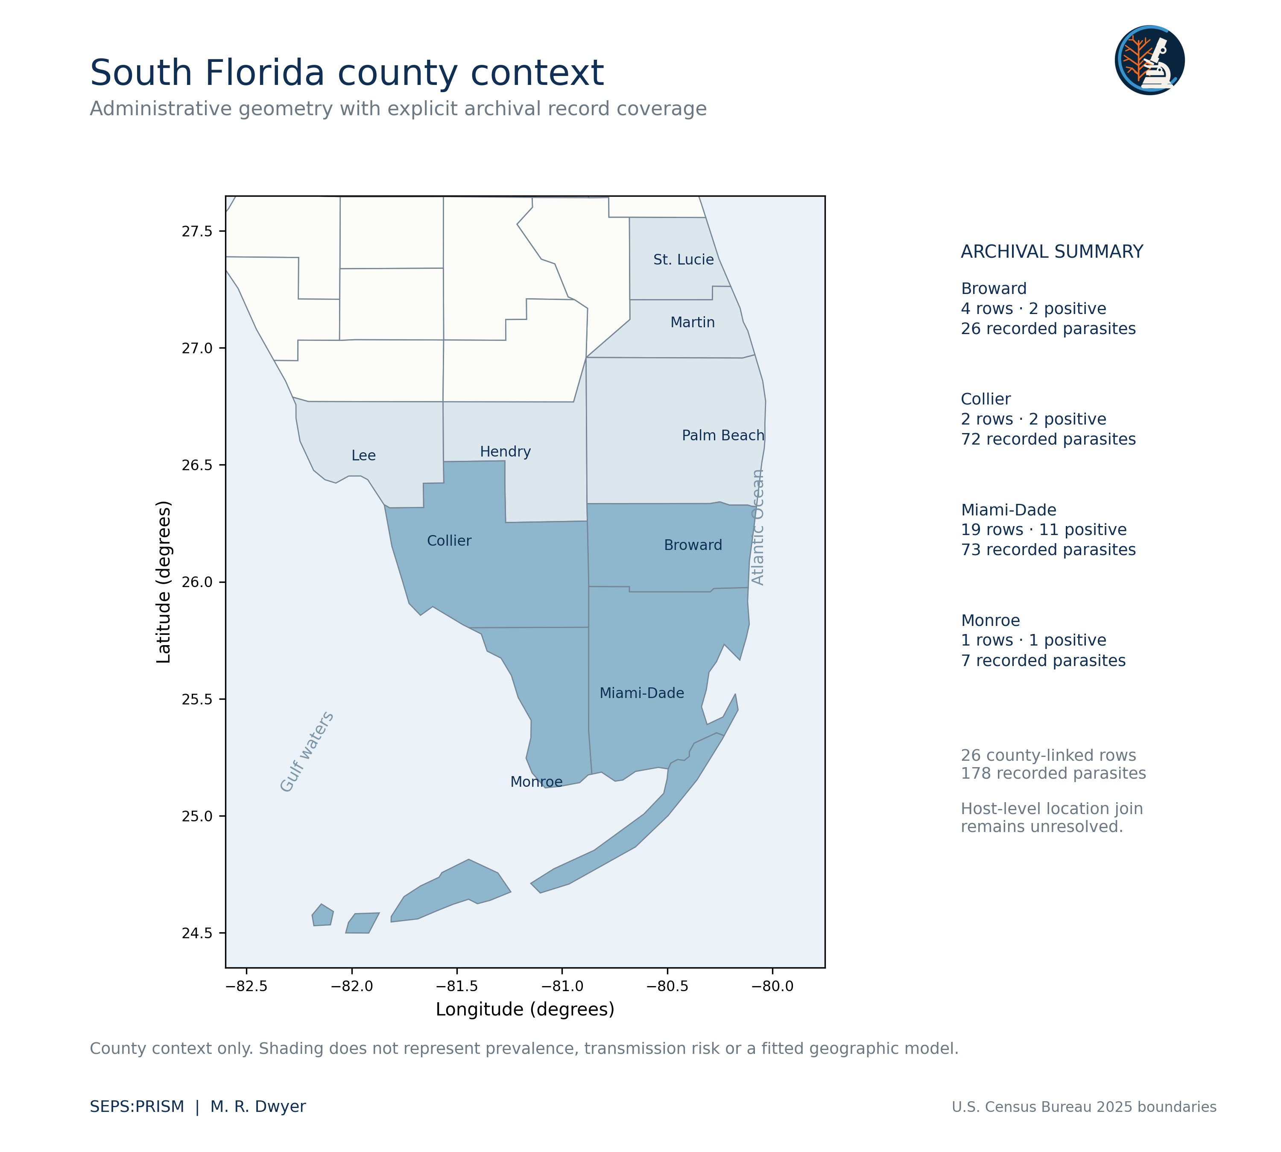
County context and record coverage
The separate county summary contains 26 rows and 178 recorded parasites.
A specimen-level join to the 28-row cottonmouth table remains unresolved.
County shading does not show infection risk.
SEPS:PRISM M. R. Dwyer
4
Notes:
U.S. Census Bureau 2025 county boundaries. SEPS archival synthesis Appendix B and regional context map.

Slide 5
Ecological inference needs linked examinations
Current findings
Next scientific comparisons
Two cottonmouth rows contribute 102 of 178 recorded parasites.
The positive lizard series describes host composition.
Published reference landmarks support a separate shape analysis.
Verify examination eligibility and effort.
Link parasite determinations to hosts and organs.
Test taxon-specific burden only after resolving the record joins.
SEPS:PRISM M. R. Dwyer
5
Notes:
SEPS Everglades Host Counts and Ecology. Context: Miller et al. (2018), doi:10.1002/ece3.3557; Miller et al. (2020), doi:10.1002/ecs2.3153.

Slide 6
Pentastome source totals reconcile
Host source label | Positive hosts | Recorded count
Basiliscus vittatus | 20 | 33
Anolis equestris | 2 | 2
Thamnophis sauritus | 1 | 3
Necropsy master workbook, Sheet1 rows 2–195. The lizard subtotal matches the earlier 22-host, 35-organism series. Agreement does not establish individual specimen joins.
SEPS:PRISM M. R. Dwyer
6
Notes:
Necropsy master workbook, Sheet1 rows 2–195. The lizard subtotal matches the earlier 22-host, 35-organism series. Agreement does not establish individual specimen joins.

