Slide 1

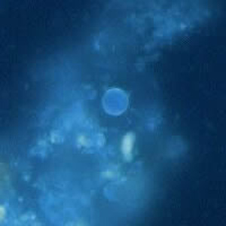
Cyclospora microscopy
Reference appearance and biological endpoints
Society for Evolutionary Parasite Systematics
CDC DPDx Cyclosporiasis. UV autofluorescence source image. Layout and proportional resizing only.
SEPS:PRISM M. R. Dwyer
1
Notes:
CDC DPDx Cyclosporiasis. UV autofluorescence source image. Layout and proportional resizing only.

Slide 2
Reader agreement varies by method and reader
Ma, Mathison, & Couturier (2025), Table 1, doi:10.1128/jcm.01084-24. All five readers evaluated the same 50 specimens. These are counts, not 250 independent specimens.
SEPS:PRISM M. R. Dwyer
2
Notes:
Ma, Mathison, & Couturier (2025), Table 1, doi:10.1128/jcm.01084-24. All five readers evaluated the same 50 specimens. These are counts, not 250 independent specimens.

Slide 3
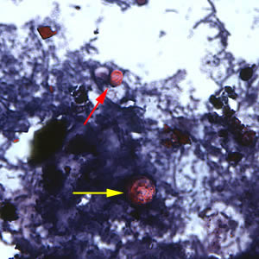
A mixed-taxon reference needs both labels
Yellow arrow: Cyclospora cayetanensis.
Red arrow: Cryptosporidium parvum.
Source arrows and pixels remain intact. Display size supplies no physical calibration.
SEPS:PRISM M. R. Dwyer
3
Notes:
CDC DPDx (2019), Cyclosporiasis, safranin-stained comparison gallery. https://www.cdc.gov/dpdx/cyclosporiasis/index.html

Slide 4
Separate biological endpoints
Endpoint | Question | Evidence requirement
Recognition | Does the object resemble the reference? | Preparation and visible morphology
Identification | Which organism does it represent? | Diagnostic comparison and adjudication
Viability | Can the organism remain biologically active? | Appropriate validated viability endpoint
Infectivity | Can it establish infection? | Appropriate experimental evidence
SEPS Cyclospora Microscopy and Inference. No SEPS diagnostic, viability or infectivity validation claimed.
SEPS:PRISM M. R. Dwyer
4
Notes:
SEPS Cyclospora Microscopy and Inference. No SEPS diagnostic, viability or infectivity validation claimed.

Slide 5
Published outcome categories
Additional error categories
One unresolved table discrepancy
Incorrect coccidian assignments and additional-coccidian reports explain most remaining evaluations.
The table retains 50 specimens per reader and method.
Reader 3 MAF: 42 agreement + 6 false negatives + 1 additional-coccidian report = 49.
We retain the published numbers and disclose the residual.
SEPS:PRISM M. R. Dwyer
5
Notes:
Ma et al. (2025), Table 1, doi:10.1128/jcm.01084-24. SEPS does not infer the unallocated outcome.

